Slide 1
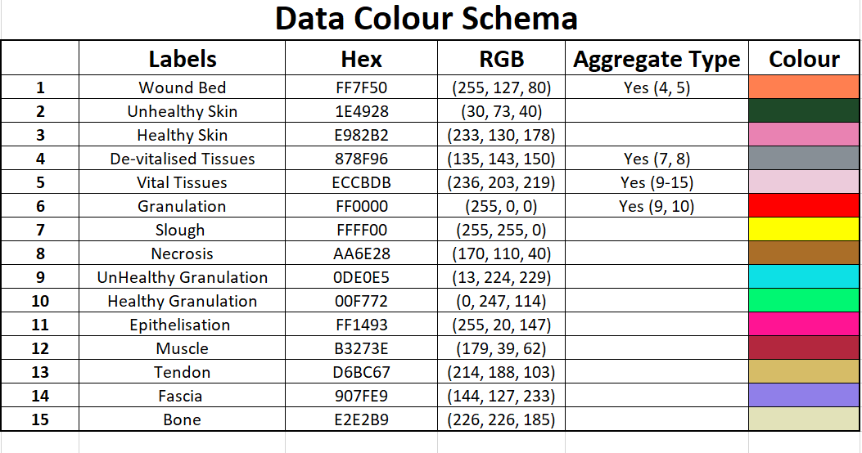

Slide 2
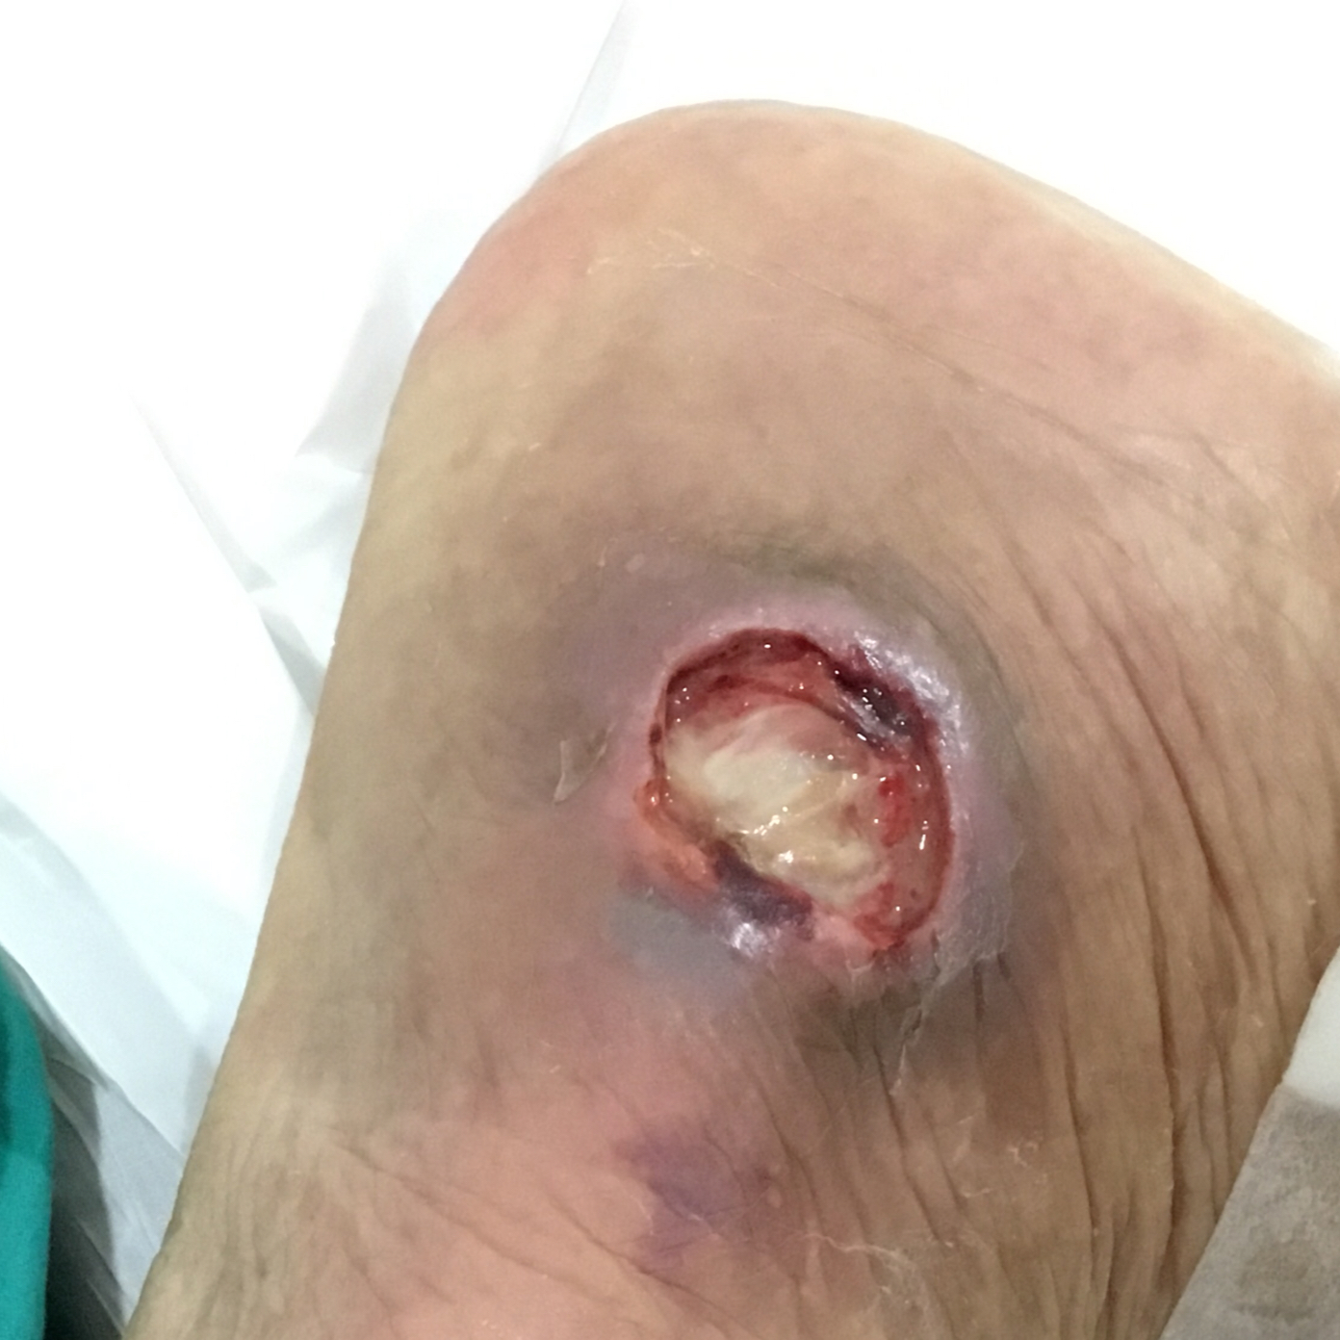
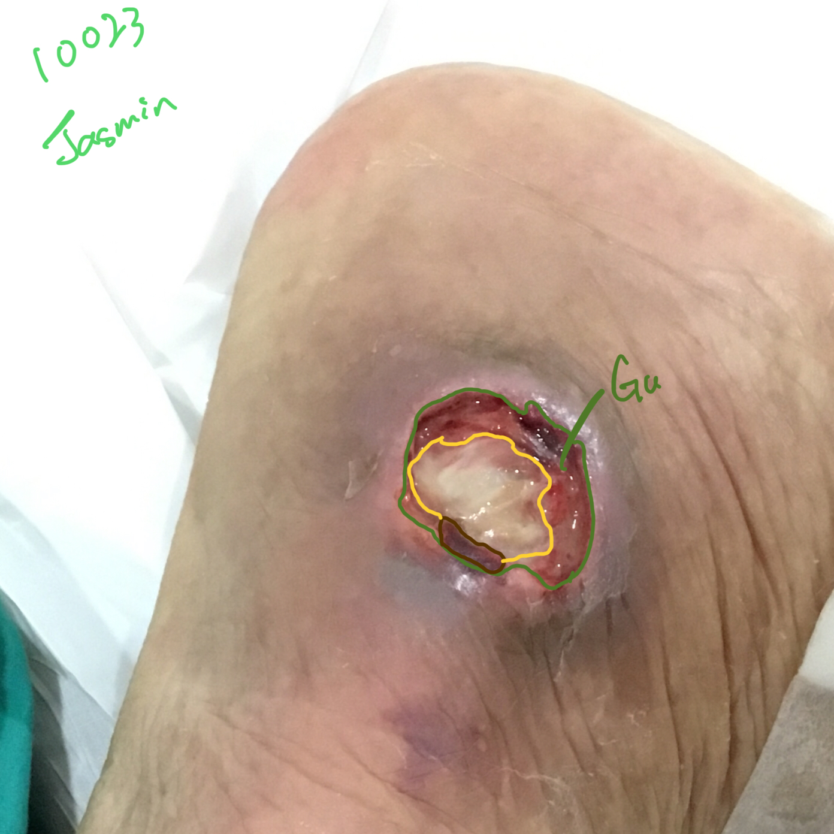

Original Wound Img
Latest Annotation
Original Mask
The area marked slough should be fascia. See the texture..
Metadata Wound Location: Ankle Wound Type:
Notes:
The area marked slough should be fascia. See the texture..

Slide 3
Notes:
Unhealthy skin

Slide 4

not sure if this wound has epithelization at all - possibly just normal healthy skin
The Epithelization is there.
Notes:
The Epithelization is there.

Slide 5
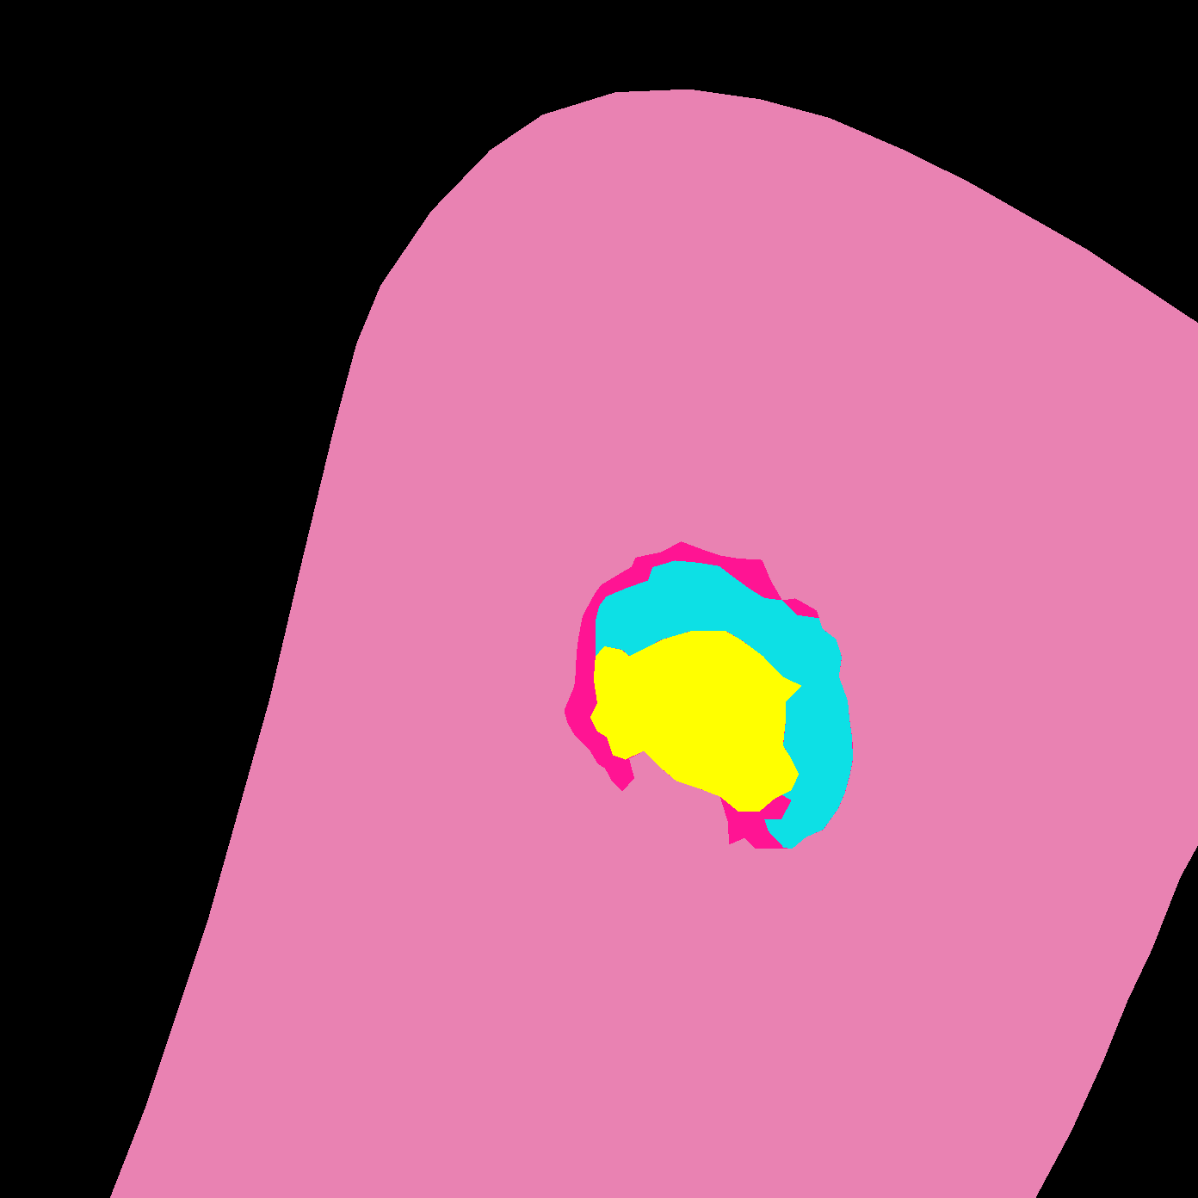
Original Wound Img
New Mask
Original Mask

Slide 6


Slide 7
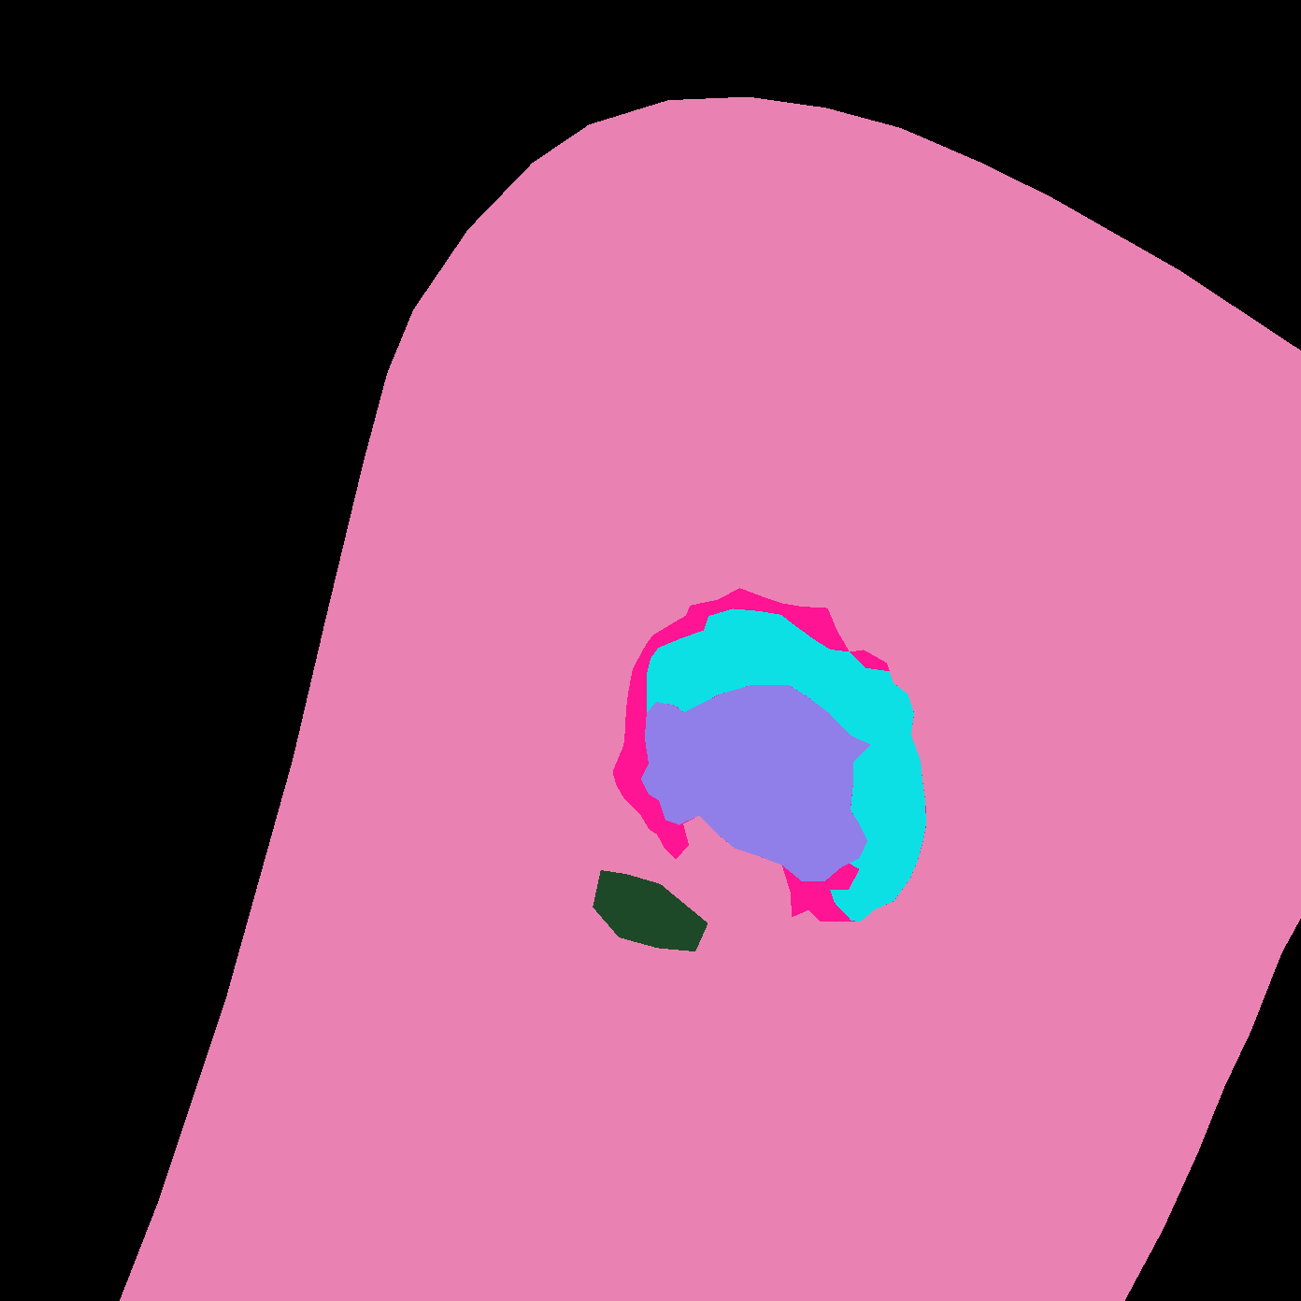
SD: ACCEPTED

